Slide 1

NYC
Subway Tracker
PROJECT DOS Presented By Lupita Lopez

Slide 2

Table of contents
01.
02.
03.
04.
INTRODUCTION
REQUIREMENTS
VISUALIZATIONS
RESOURCES

Slide 3

01.
Introduction
The purpose of this project
Help NYC tourists travel through the subway network in the Big Apple.

Slide 4

02.
Included within this project
REQUIREMENTS
Python Flask - RESTful API - HTML/CSS - JavaScript
_
D3 - Leaflet
_
Mongodb -Jsonify - Py.files
_

Slide 5
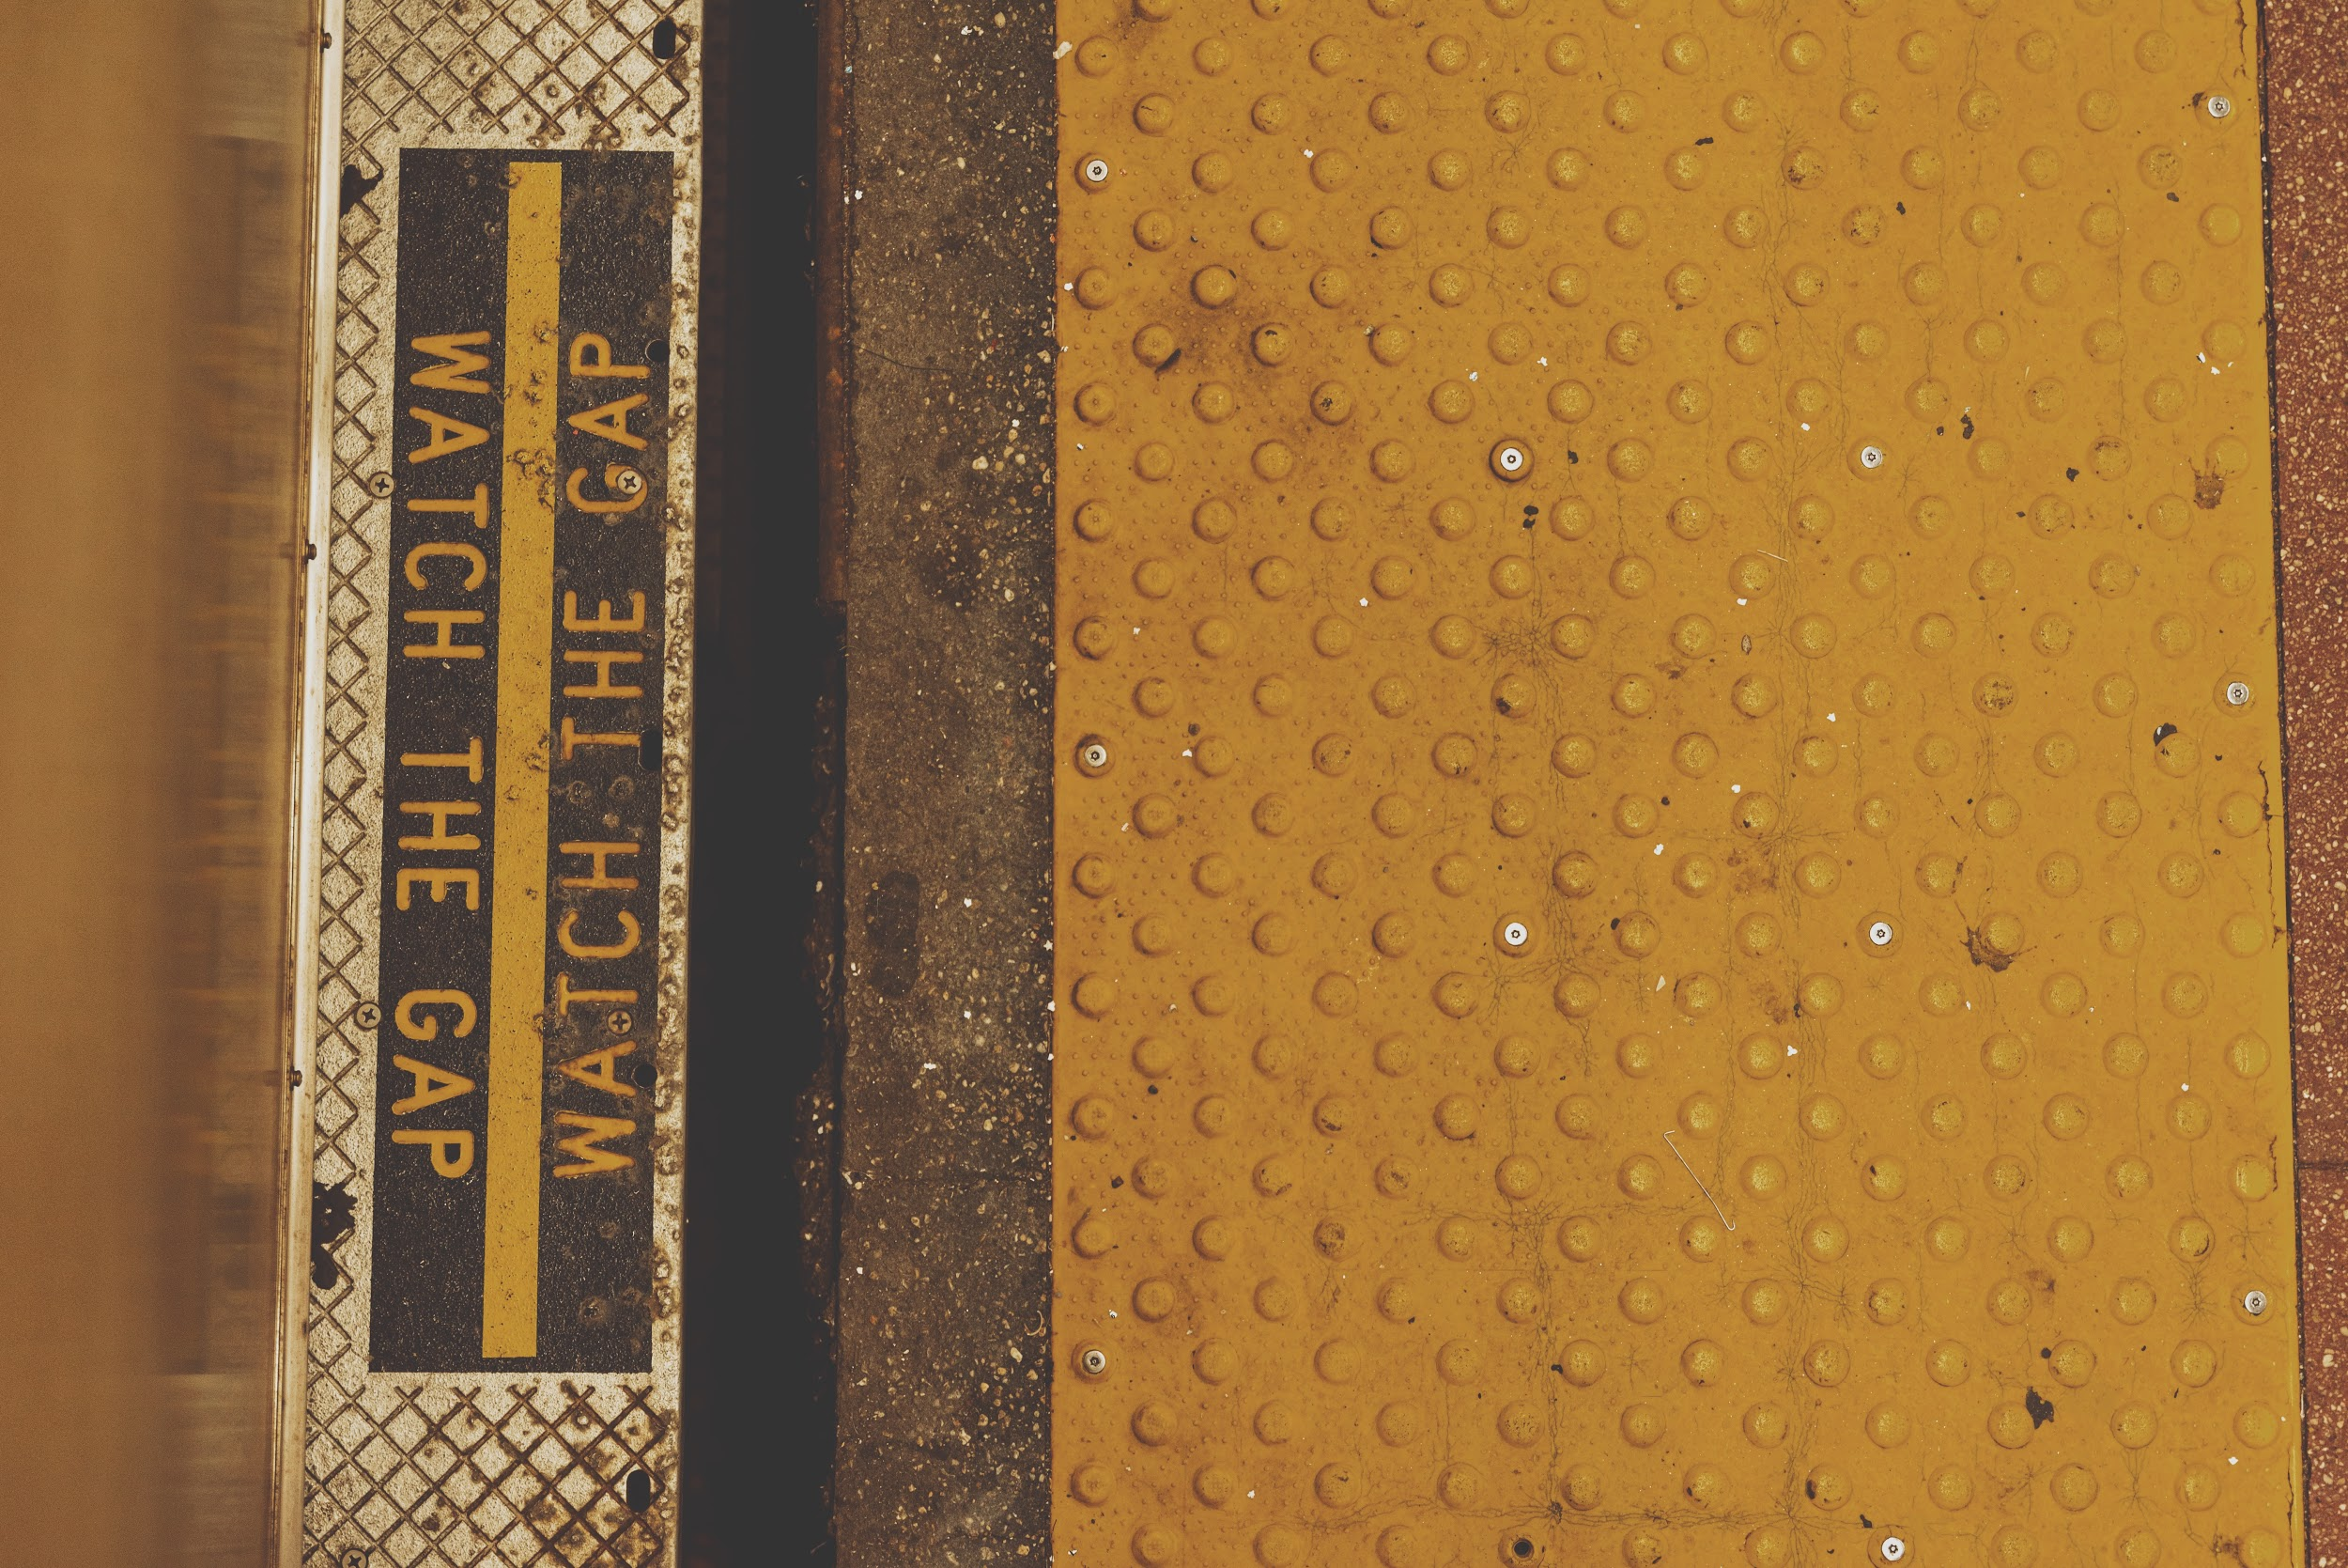
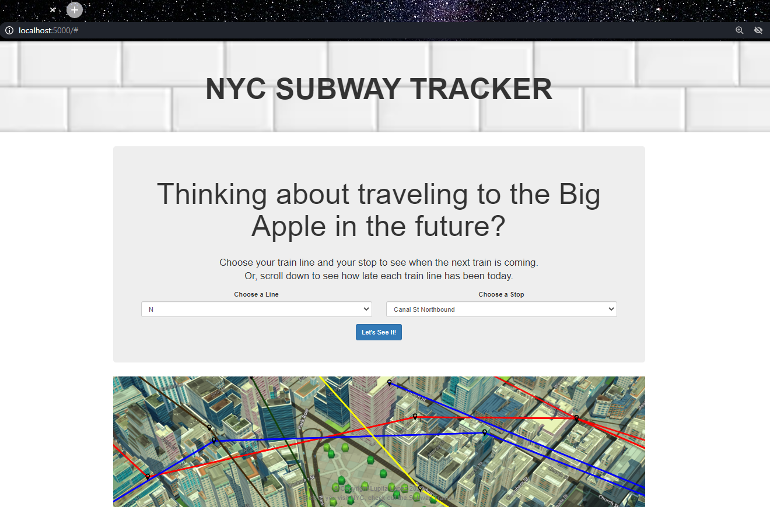
Creating a online tool for NYC’s subway travelers.
03.
VISUALIZATION

Slide 6

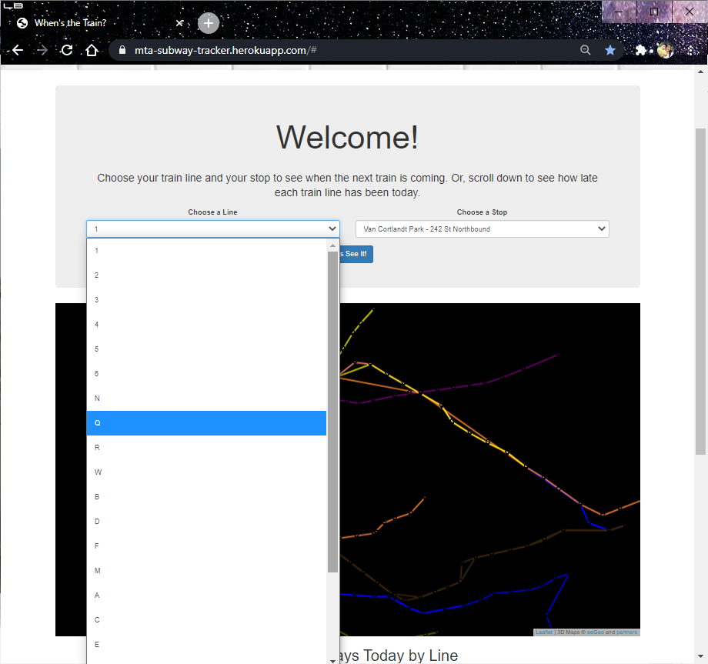
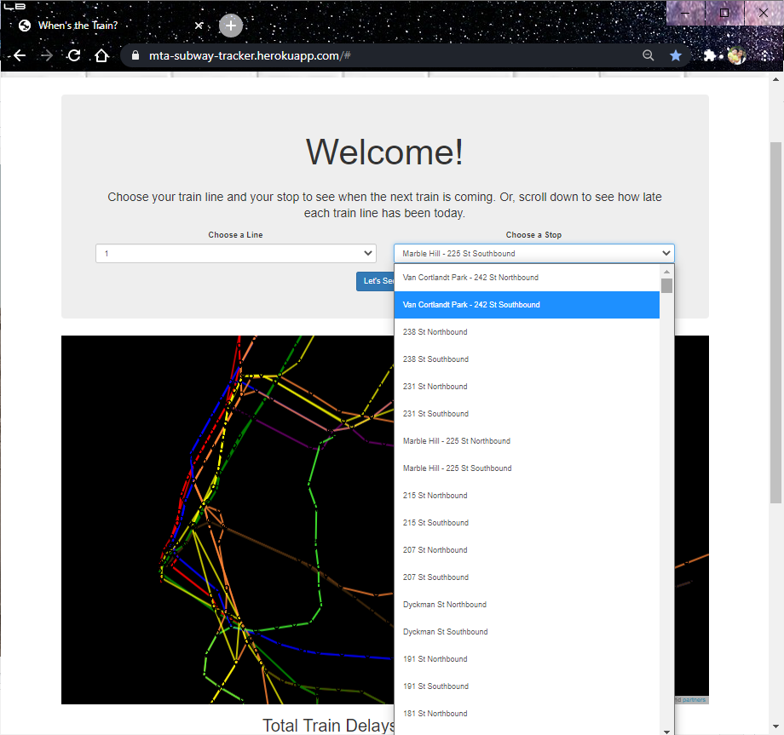
03.
Choose a Train Line; Choose a Stop.
VISUALIZATION

Slide 7

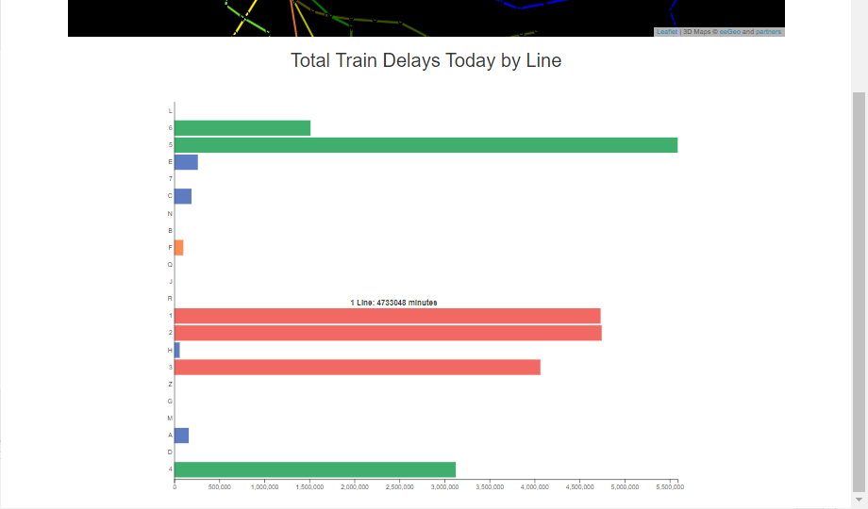
Total Train Delays Today by Line.
03.
VISUALIZATION

Slide 8

04.
RESOURCES
NYC Transit Data - Kaggle.com
NYC Open Data - City of New York
MTA Dataset - Data.gov
Template - Slidesgo
Icons - Flaticon
Infographics - Freepik

Slide 9
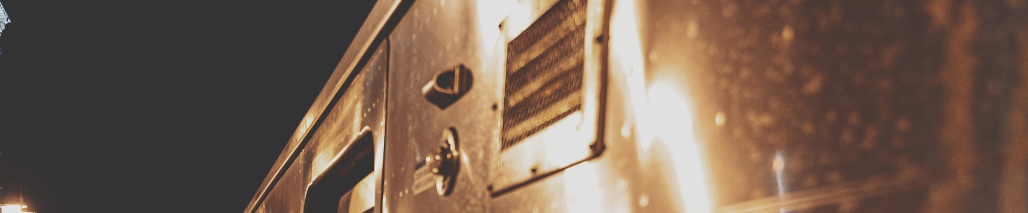
Contact
Get into - myRepo
Don’t get lost - gMaps
GELOPEZ1984@gmail.com
NYC Subway Tracker - herokuapp
(Work in process)

Slide 10
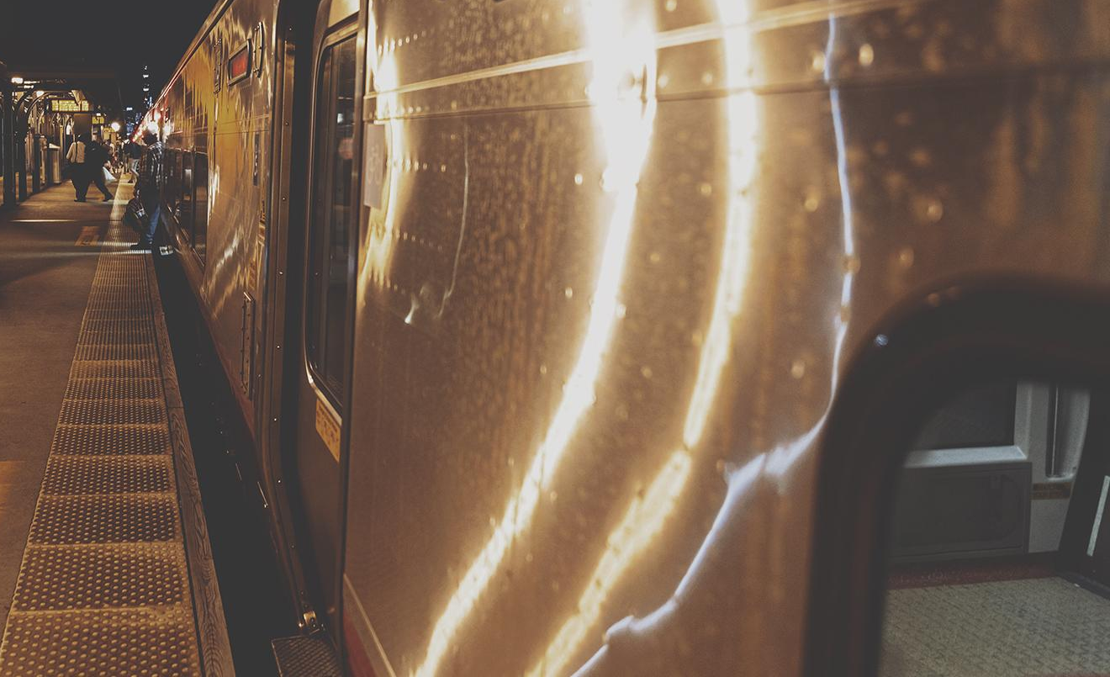
THANKS!
Does anyone have any questions?

